Slide 1
¡Bienvenidos!
1st grade teachers
Our goal for tonight is to discuss homework and show how you can help your child at home. If you have further academic specific questions, please feel free to ask at the question time at the end. Thanks.
Sra. Stacey daSilva
Sra. Gina Godinez
Sra. Edna Rico
Srta. Kristi Schipper

Slide 2
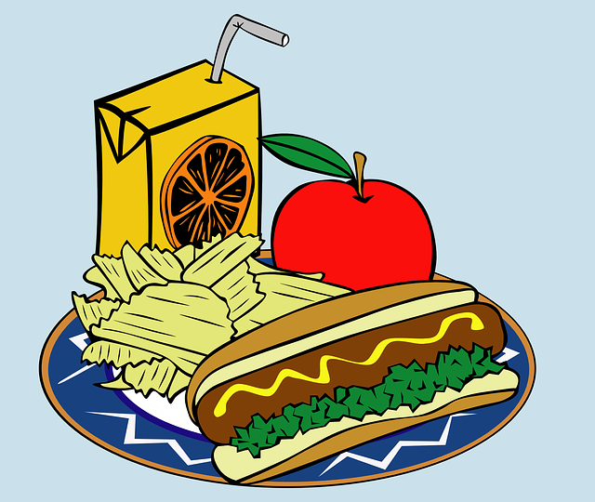
snack and lunch
* lunch website (also app)
* lunch is 15 min
* snack 2 times a day
* allergy info
* recommended snacks
* birthdays
fhps.nutrislice.com

Slide 3
Reading
* stamina
* centers (Daily 5, Cafe)
* aide help
* Converse with students during lunch and recess.
* Read with small groups.
* Read with individuals.
* Assist with writing and vocabulary
* Assist with math centers.
* STARS

Slide 4
Homework
Artes de Lenguajes
* baggie books
* sight words
* Senderos
* A-Z readers
Matemáticas
connection to at home
addition and subtraction fluency practice

Slide 5
Questions
¿ ?
¿ ?
¿ ?
¿ ?

